Slide 1

Architecture Roadmap
Planning for Agility, Reuse and Asset Consolidation
Work in Progress…..

Slide 2

Goal
To draft an architecture blueprint and roadmap to dramatically increase business agility, increase reuse of the right assets and eliminate use of the wrong assets to optimize IT’s value and reduce costs.

Slide 3
Cross Functional Team
Functional Area | Resource
Enterprise Architecture | Jeff Wallk, Tony Sciacca
Demand Management | Ed Schipp, Bob Balogh, Dan Swanson, Bob Gerber
Support | Mike Slomanski, Joe Hendricks
App Dev (Non-SAP) | Jenny Hughs, Glenn Therkelsen, Mike Savatic
App Dev (SAP) | Cindy Swiatowiec
App Dev (Integration) | Jay Kolli, Chad LaCrosse
Operations | Craig Burnett, David Santiago, Holly Kay

Slide 4
Objectives
Build a series of reference models from which to base technology decisions & deliver business services
Introduce a formal architecture development practice
Define a service-based model for delivering business value.
Evolve the buy vs. build model for IT
Define a set of architecture objectives
Define an architecture blueprint
Build a roadmap of projects to implement the blueprint

Slide 5
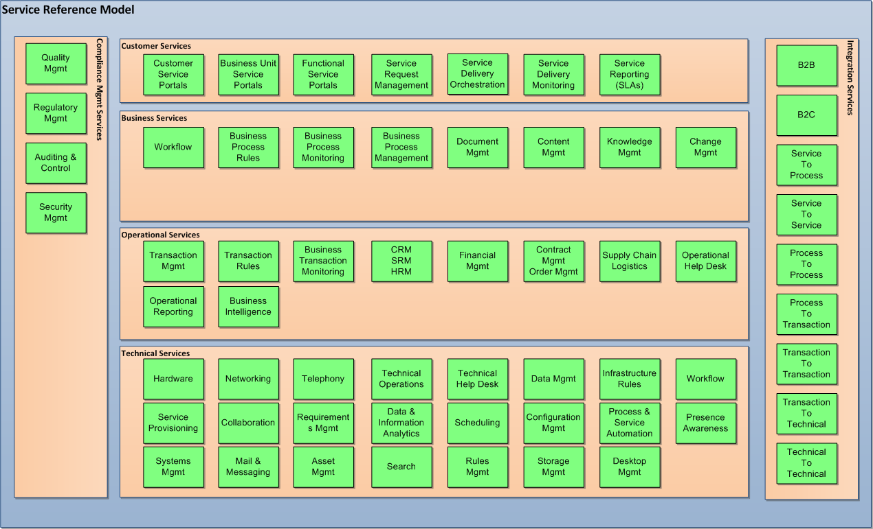
Service Reference Model

Slide 6
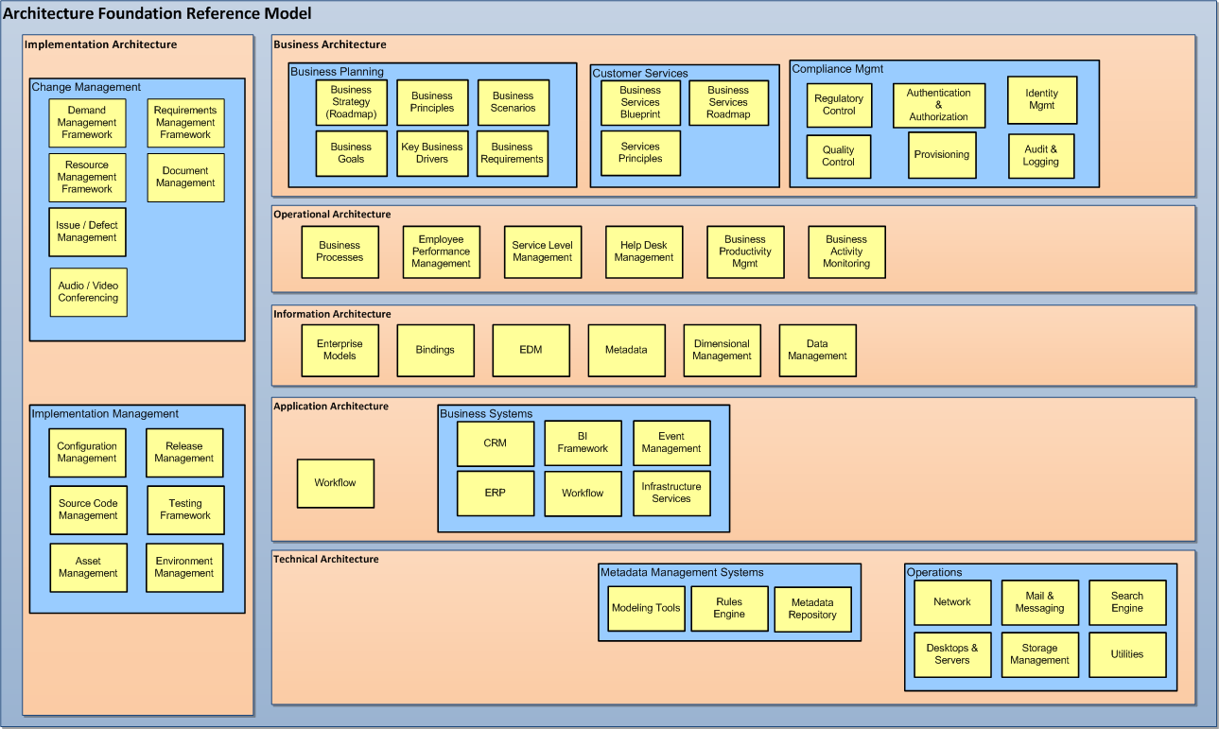
Architecture Reference Model

Slide 7
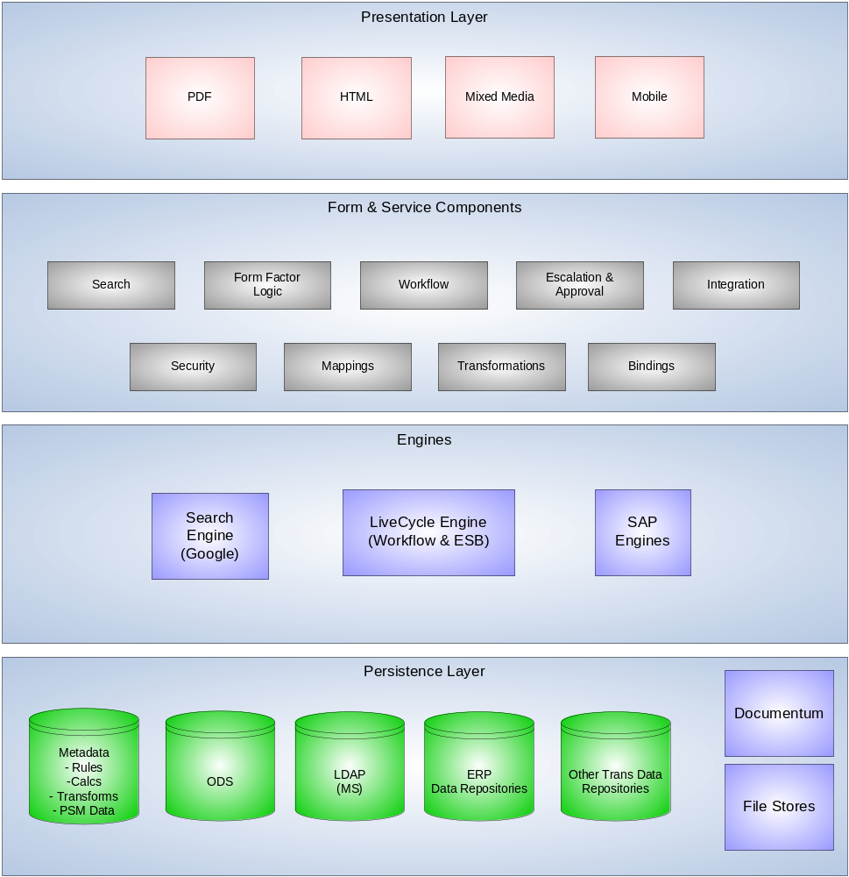
Physical Overview

Slide 8
Adaptable EA Maturity Model
Level 1 Point Solution Based: The process and information system support infrastructure represent a patch quilt of point solutions to temporal business problems. There is no unifying architecture or end-to-end process design.
Level II Federated Solution Based: Departmentally based processes and individually procured systems are stitched together through ad hoc agreements. This is an improvement over Level I in that the IT department has developed an integration strategy that can accommodate end user needs given some tradeoffs
Level III Central Solution Based: Process and system integration forced on enterprise based on ERP best practice model.
Level IV Service-Component Based Architecture: Highly adaptive and agile process and IT infrastructure. However, to-date, [what] has required commitment to a high percentage of custom software and the associated skills and investment, as most packages software cannot be emended to suit a component architecture.
Level IV Business Process Based: New wave in business process implementation where the business process model can be provisioned into running applications, virtually eliminating major bottlenecks in SDLCs.

Slide 9
Adaptable EA Maturity Model
Point Solution Based Level 1 | Federated Solution Based Level II | Central Solution Based Level III | Service-Component Based Level IV | Business Process Based Level V
Weak organizational governance structure Poor cooperation among Enterprise entities – Politically driven solutions Process and IT redundancies and disconnects Unreliable and redundant data Ineffective performance indicators Crisis management is a staff core competency Erratic service quality – Focus on functional Organization objectives vs. customer needs | United Nations style governance structure Organizational entities have reached a level of accommodation Process and IT redundancies and disconnects are arbitrary Data reconciliation is a primary focus of IT Performance indicators tend to be ROI driven Diplomacy is a staff core competency Standard services tend to be reliable Disruptions are out-of-the ordinary Demand difficult to accommodate | Effective governance structure Predictable core shared service performance with cross organizational cooperation Major reductions in process/IT redundancies and disconnects Reliable operational data with limited business analytics Performance indicators tent to include operational Efficiencies along with ROI focus Process management is a staff core competency Predictable service quality – sub optimization of Competitive differentiators – Process change and customer focus is difficult to obtain | Shared enterprise goals driving governance High level of cross organizational cooperation Integrated end-to-end Adaptive processes – But heavy reliance on IT On demand information with business analytics Instrumentation of competitive dynamics Requires best of class IT staff and cross organizational IT literacy Adaptive and agile customer driven processes | Shared enterprise goals Driving governance High level of cross Organizational cooperation Integrated end-to-end adaptive processes – End user controlled On demand information with business analytics Instrumentation of competitive dynamics Less of a role for IT – removal of the SDLC as a Change impediment Adaptive and agile customer Driven processes – ability to model and simulate change

Slide 10
SOA Principles
Services are reusable Regardless of whether immediate reuse opportunities exist, services are designed to support potential reuse.
Services share a formal contract For services to interact, they need not share anything but a formal contract that describes each service and defines the terms of information exchange.
Services are loosely coupled Services must be designed to interact without the need for tight, cross-service dependencies.
Services abstract underlying logic The only part of a service that is visible to the outside world is what is exposed via the service contract. Underlying logic, beyond what is expressed in the descriptions that comprise the contract, is invisible and irrelevant to service requestors.
Services can be bundled Services may compose other services. This allows logic to represented at different levels of granularity and promotes reusability and the creation of abstraction layers.
Services are autonomous The logic governed by a service resides within an explicit boundary. The service has control within this boundary and is not dependent on other services for it to execute its governance.
Services are stateless Services should not be required to manage state information, as that can impede their ability to remain loosely coupled. Services should be designed to maximize statelessness even if that means deferring state management elsewhere.
Services are discoverable Services should allow their descriptions to be discovered and understood by humans and service requestors that may be able to make use of their logic.

Slide 11
Types of Services
Service Model | Description
Application service | A generic category used to represent services that contain logic derived from a solution or technology platform. Services are generally distinguished as application services when creating service abstraction layers.
Business service | A generic category used to represent services that contain business logic. When establishing specialized service layers, services that fall into the business service layer are collectively referred to as business services. However, individually these services are classified as entity-centric or task-centric business services.
Controller service | A service that composes others. Variations of this model exist, depending on the position of the controller in the composition hierarchy. The parent controller service can be classified as the master controller and a service that composes a subset of a larger composition can be labeled a sub-controller.
Coordinator services | Three service models are derived from the concept of coordination: the coordinator, the atomic transaction coordinator, and the business activity coordinator. All three models are specific to the WS-Coordination specification and related protocols.
Entity-centric business service | A business process-agnostic variation of the business service that represents one or more related business entities. This type of service is created when establishing a business service layer.
Hybrid service | A service that contains both business and application logic. Most services created as part of traditional distributed solutions fall into this category. When organizing services into abstraction layers, hybrid services are considered part of the application service layer.
Integration service | An application service that also acts as an endpoint to a solution environment for cross-application integration purposes.
Process service | A service that represents a business process as implemented by an orchestration platform and described by a process definition. Process services reside in the orchestration service layer.
Task-centric business service | A business process-specific variation of the business service that represents an atomic unit of process logic. Task-centric services are different from process services in that the process logic is provided by the underlying service logic, not by a separate process definition.
Utility service | A service that offers reusable logic. This category is primarily intended for the classification of solution-agnostic application services. However, it also can be used to refer to reusable business services.
Wrapper service | A type of integration service that encapsulates and exposes logic residing within a legacy system. Wrapper services are commonly provided by legacy system vendors and therefore frequently introduce non-standardized interfaces.

Slide 12
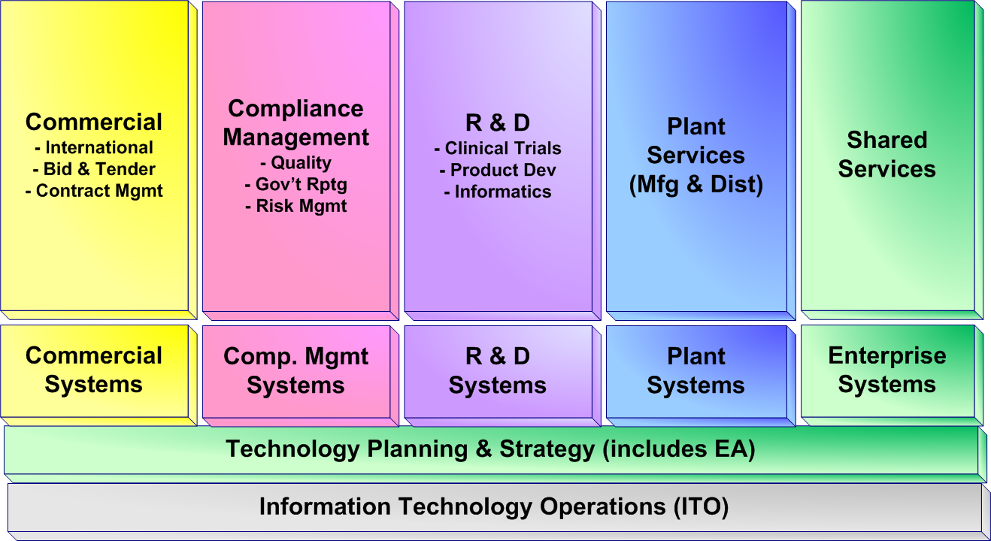
Application Portfolio View

Slide 13
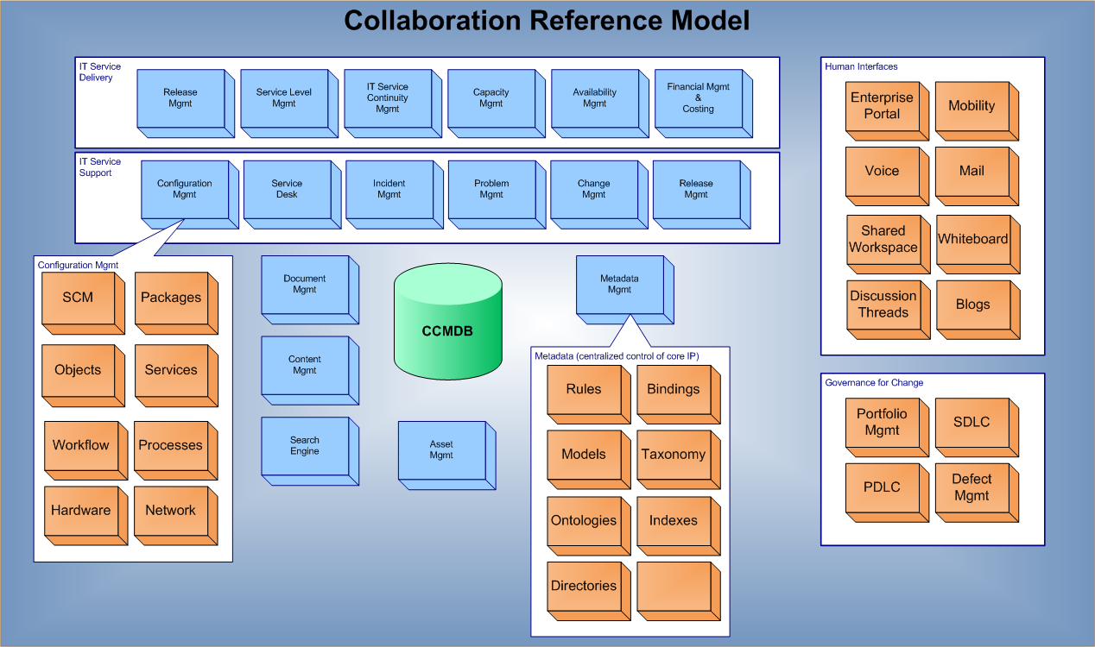
Collaboration Model

Slide 14
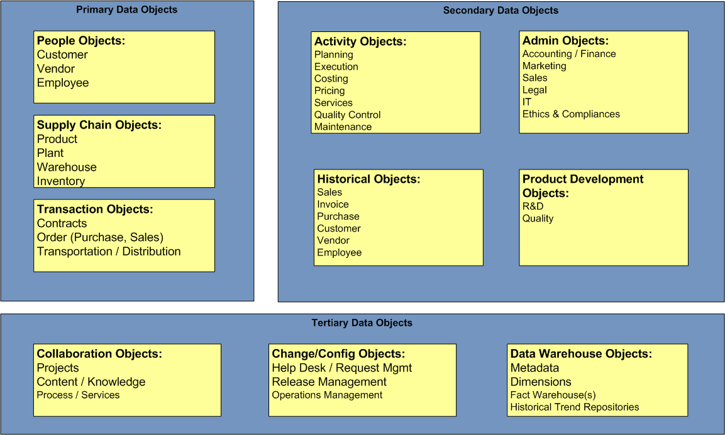
Data Reference Model

Slide 15
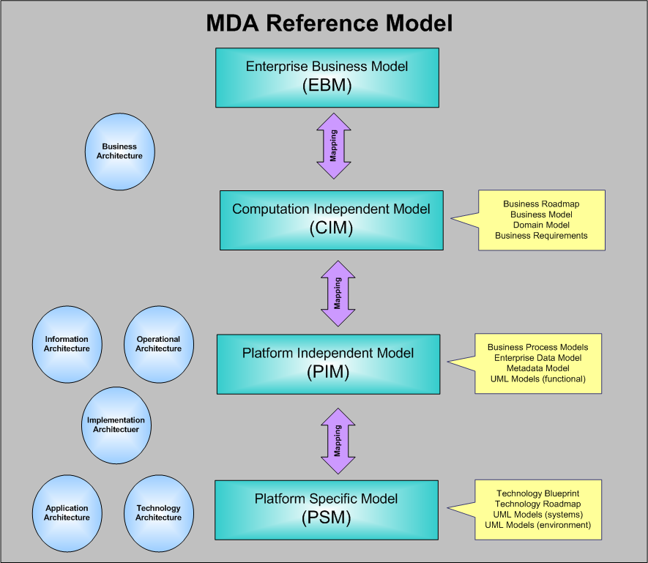
Architecture Reference Model

Slide 16
Value Proposition

Slide 17
Business Drivers

Slide 18
Driving Agility

Slide 19
Driving Asset Reuse

Slide 20
Driving Asset Consolidation

Slide 21
Virtual Portal Strategy

Slide 22

Transition (Buy vs. Build vs. Hybrid)
Ideal
Custom Apps
Services
Composite Apps
Differentiated capability built on common platforms
(lower TCO)
Business Value Delivered by IT
Packaged Apps
Lower TCO,
but loss in differentiated capability
Reduction in TCO

Slide 23
Transition (Tools to Services)

Slide 24
Transition (Paper to Automation)

Slide 25
Transition (Documents to Data)

Slide 26
Roadmap

Slide 27
Service Portfolio

Slide 28
Roadmap of Customer Deliverables

Slide 29
Maturity Model

Slide 30
Reference Architecture

Slide 31
Key Definitions

Slide 32
Business Model vs. Service Model

Slide 33
Connecting Business & Service Models

Slide 34
Event Design Model

Slide 35
Buy vs. Build vs. Services

Slide 36
Event Planning Model

Slide 37
Architecture

Slide 38
Layer Overview (Presentation)

Slide 39
Layer Overview (BPMS)

Slide 40
Layer Overview (Integration)

Slide 41
Layer Overview (Transactional)

Slide 42
Layer Overview (Data Persistence)

Slide 43
Layer Overview (Business Intelligence)

Slide 44
Leveraging Design Patterns

Slide 45
Platforms & Tools

Slide 46
Bindings & Connectors

Slide 47
Appendices:

Slide 48
ATAM – Software Architecture Eval Method
The SEI's Architecture Tradeoff Analysis Method® (ATAM®) is the leading method in the area of software architecture evaluation. An evaluation using the ATAM typically takes three to four days and gathers together a trained evaluation team, architects, and representatives of the architecture's various stakeholders. Proven benefits of the ATAM include
  clarified quality attribute requirements
  improved architecture documentation
  documented basis for architectural decisions
  identified risks early in the life-cycle
  increased communication among stakeholders

Slide 49
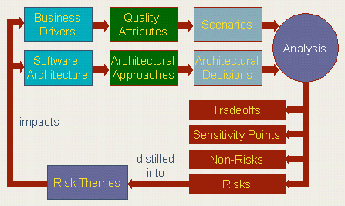
ATAM – Software Architecture Eval Method

Slide 50
ATAM – Software Architecture Eval Method
Business drivers and the software architecture are elicited from project decision-makers. These are refined into scenarios and the architectural decisions made in support of each one. Analysis of scenarios and decisions results in identification of risks, non-risks, sensitivity points, and tradeoff points in the architecture. Risks are synthesized into a set of risk themes, showing how each one threatens a business driver.
The most important results are improved architectures. The output of an ATAM is an out-brief presentation and/or a written report that includes the major findings of the evaluation. These are typically:
  the architectural styles identified
  a "utility tree" - a hierarchic model of the driving architectural requirements
  the set of scenarios generated and the subset that were mapped onto the architecture
  a set of quality-attribute specific questions that were applied to the architecture and the responses to these questions
  a set of identified risks
  a set of identified non-risks

Slide 51
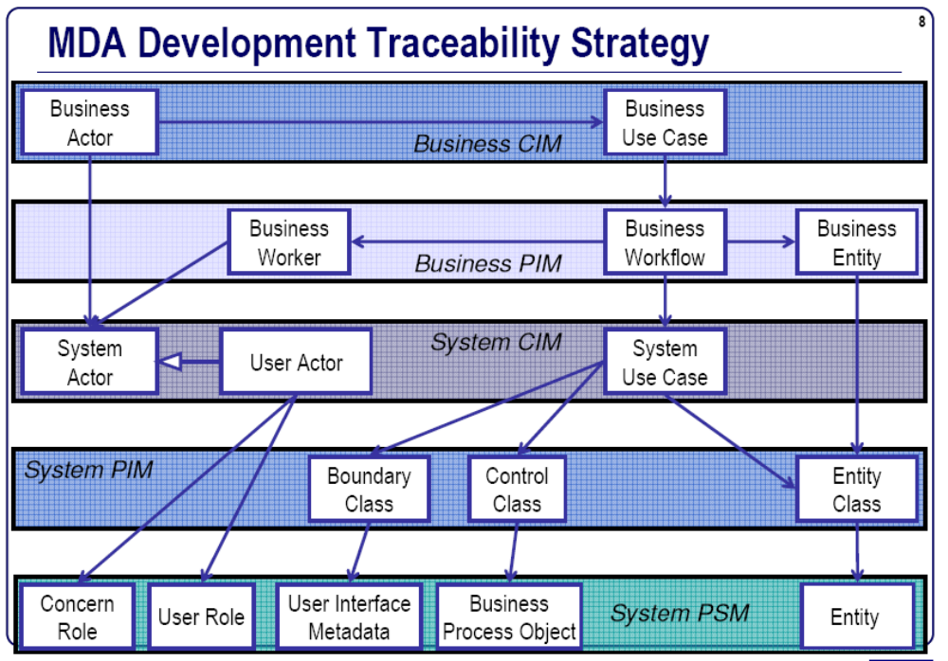
MDA

Slide 52
Standards
CIM – Common Information Model
PIM – Platform Independent Model
PSM – Platform Specific Model
IDL – Interface Design Language
DMTF – Distributed Mgmt Task Force
OMG – Object Mgmt Group
UML – Unified Modeling Language

Slide 53
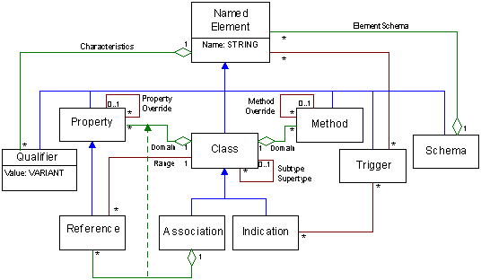
CIMMeta Schema

Slide 54
Types of Integration
Intranet: Corporate integration
Internet: Customer integration
Extranet: Supply chain integration
Mobilenet: Time and place integration
Omninet: Device and product integration

Slide 55
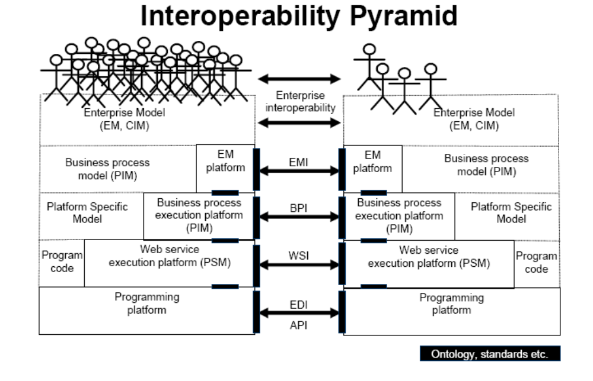
Interoperability Pyramid

Slide 56
Definitions
Abstraction: Denotes the essential characteristics of an object that distinguish it from all other kinds of objects and thus provide crisply defined conceptual boundaries.
  Example: A Cheeseburger - is good to eat and fun to cook.
Modularity: Decomposition of abstractions into discrete units.
  Example: The various “layers” of a Cheeseburger. (e.g., bun, lettuce, ketchup, mayonnaise, burger, cheese, onions, pickles, etc.)
Encapsulation: Process of compartmentalizing the elements of an abstraction that constitute its structure and behavior; encapsulation serves to separate the interface of an abstraction and its implementation.
  Example: To cook the Cheeseburger: - Is the stove available? Are the burners working? Are the ingredients available?
  To eat the Cheeseburger: - Is it made correctly? Is my plate clean?
Hierarchy: A ranking or ordering of abstractions.
  Example: A Cheeseburger is really a subclass of a Hamburger with the addition of cheese, which is a subclass of Sandwich, which is in turn a subclass of the Hierarchical superclass Food.
Key Elements:
  Classes – A collection of the definitions of state, behavior, and/or identity.
    Properties , Methods
  Objects– Instances of a class.
  Associations–Relationships between classes or instances of classes.
    Dependency, Identity , Aggregation, Composition, And others

Slide 57
OO Basics
Instances are things.
Properties are attributes.
Relationships are sets of attributes.
Classes are types of things.
Subclasses are subtypes of things.

Slide 58
Exhibit A: Domain Analysis for EA Vision
There are 4 areas of management that will drive the direction for an EA:
  Business Management
  Product Management (*)
  Risk Management
  Application & Service Management
  (*) PLM & Product Marketing
The EA must be able to support all of these areas now and in the future by embracing agreed upon EA Guidelines, using effective/efficient Change Management and overseeing all IT investments using a portfolio-driven governance framework.

Slide 59
Exhibit A: Business Management
Feature Management
Content Management
Process Management
Exception Management
Rules Management
Constraint Management
Contract Management
  SLAs
  Document Mgmt
  Contractual Compliance
Regulatory Management
  Audits (internal / External)
  Regulatory Compliance (SOX, HIPAA)
ERP & Asset Management
CRM & SRM
BPM
Investor Management

Slide 60
Exhibit A: PLM & Product Management
Market Research & Alignment with VOC
Strategic Planning
Product Planning (financial and pipeline mgmt)
Product Funding
Product Lifecycle Management (inception through design)
Product Engineering (bringing a design concept from pilot through realization for manufacturing)
Product Certification (for FDA approval)
Product Commercialization (includes tracking product model through Bill of Materials, product assembly [including line interruptions] and ongoing enhancements)
Product Release Management Strategy
  Pilot, Alpha, Beta
  Internal vs. External Training & Rollout Planning
Demand Driven Supply Chain

Slide 61
Exhibit A: Risk Management
Physical Security Mgmt
  Building Security
  Human Resources
  Assets
  Contingency Planning
Quality & Compliance Mgmt
  Requirements Mgmt
  Methodologies & Best Practices
  Tool Board
  Audits, Inspections
  Test Planning & Execution
  Defect Management
  Metrics Tracking & Reporting
System/Data Security Mgmt
  Authentication / Authorization
  Perimeter Security
  Identity Management
  Intellectual Property
  Data Releasability
    Data
    Communications
    Products
    Deliverables / Orders

Slide 62
Exhibit A: Application & Service Mgmt
Application & Service Management
N-Tiered approach (Presentation, Business, Metadata, Data)
Component Reuse Strategy
Development Methodologies
Document Management
Scheduling Architecture
Demand Prioritization (as driven by Business, SRM, CRM, Regulatory)
Planning & Execution Management
Monitoring & Alerts
Capacity Planning
Enterprise Search
Enterprise Collaboration
Centralized Metadata

Slide 63
Model of All
Process
Users
Data
Hardware

Slide 64
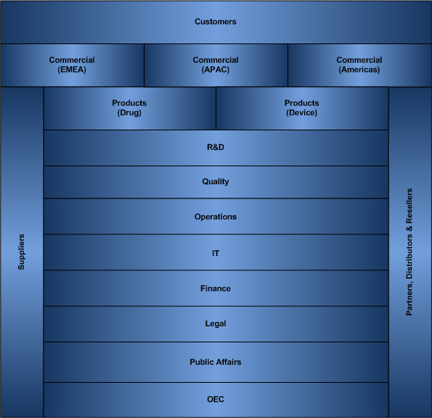
Business Model

Slide 65
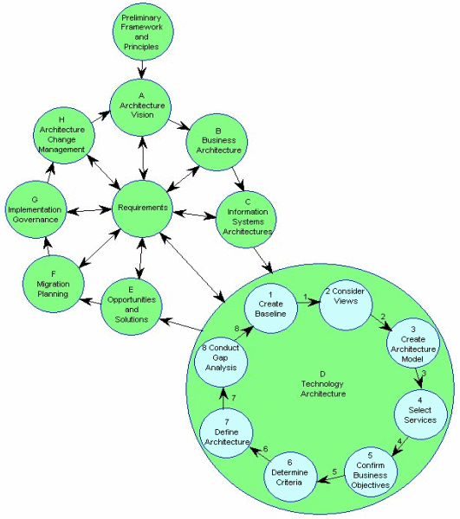
TOGAF

Slide 66
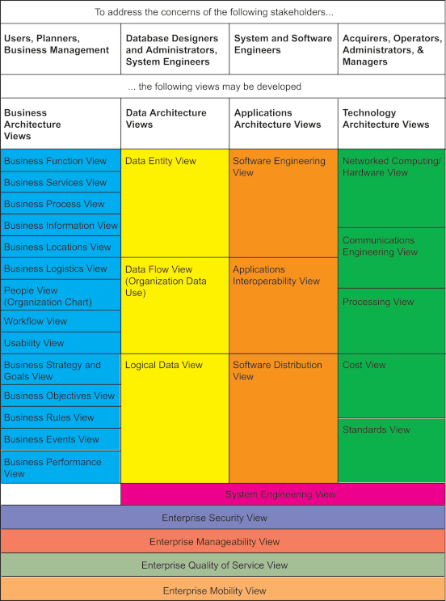
Architecture Views

Slide 67
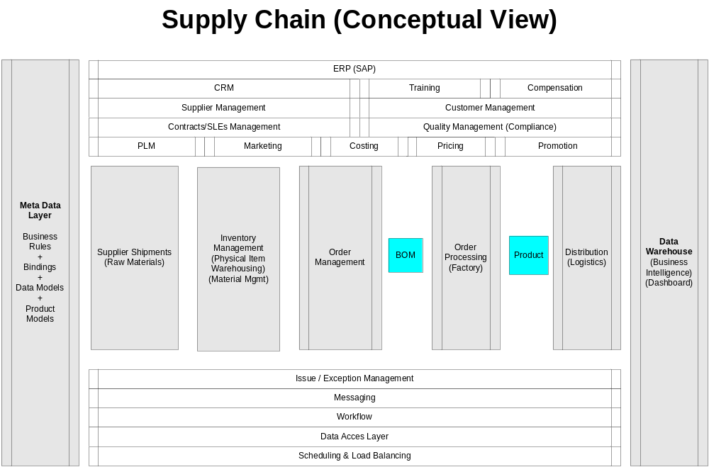
Blueprint: EA Future State (Conceptual)

Slide 68
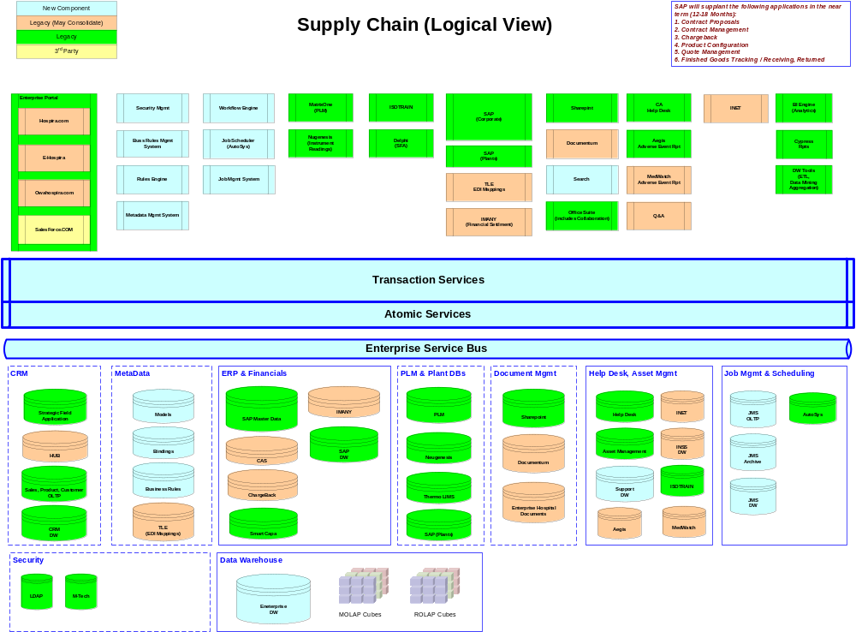
Blueprint: EA Future State (Logical)

Slide 69
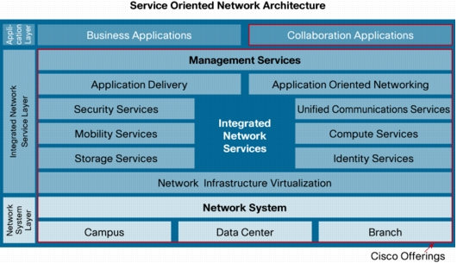
Infrastructure Services (SONA)

Slide 70
Thank You

